Slide 1
Lending Club EDA Case Study
14-Aug-2023
Neelima R

Slide 2
Business Objective
To identify these risky loan applicants, then such loans can be reduced thereby cutting down the amount of credit loss. Identification of such applicants using EDA is the aim of this case study.
In other words, the company wants to understand the driving factors (or driver variables) behind loan default, i.e. the variables which are strong indicators of default. The company can utilize this knowledge for its portfolio and risk assessment.
To develop your understanding of the domain, you are advised to independently research a little about risk analytics (understanding the types of variables and their significance should be enough).

Slide 3
Steps for EDA
Data Understanding and Cleaning
Delete columns with maximum NaN values
Replacing the Missing values with most repeated value
Splitting/Merging the columns and Adding/Deriving new columns
Univariate Analysis
Segmented Univariate Analysis
Bivariate Analysis

Slide 4
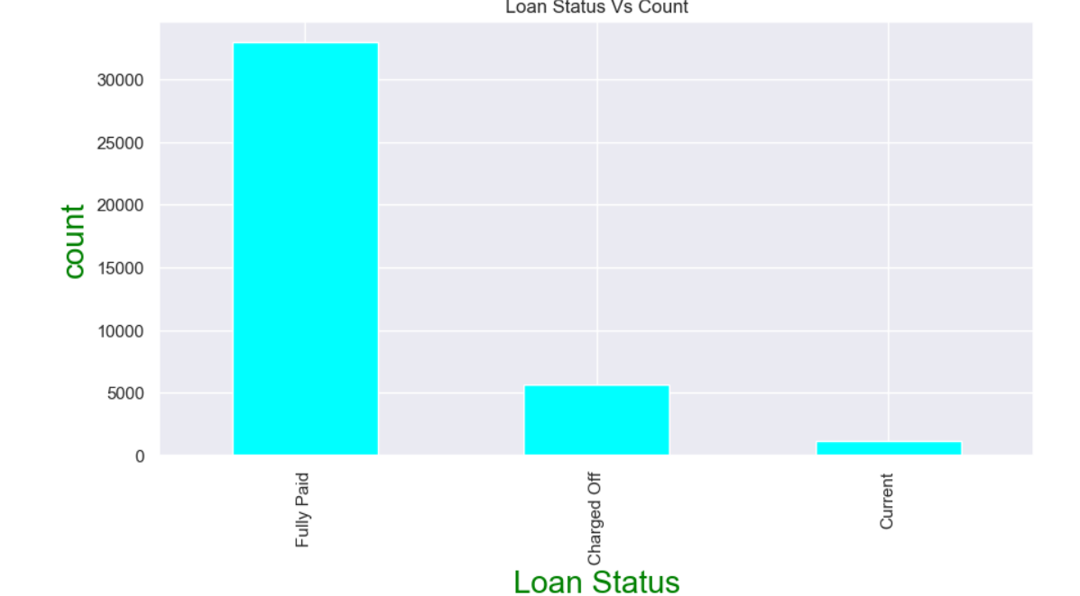
Loan Status VS Defaulted Customers
Analysing only the Charged off and Current Loan Borrowers

Slide 5
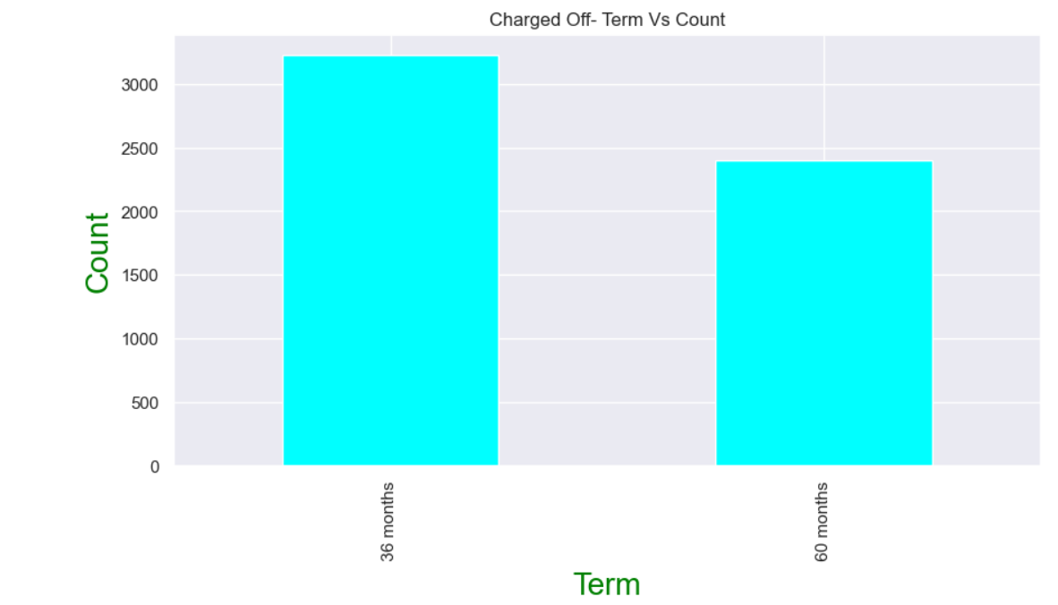
Term VS Default customers
Higher percentage of Loan Borrowers are defaulting with term of 36 months

Slide 6
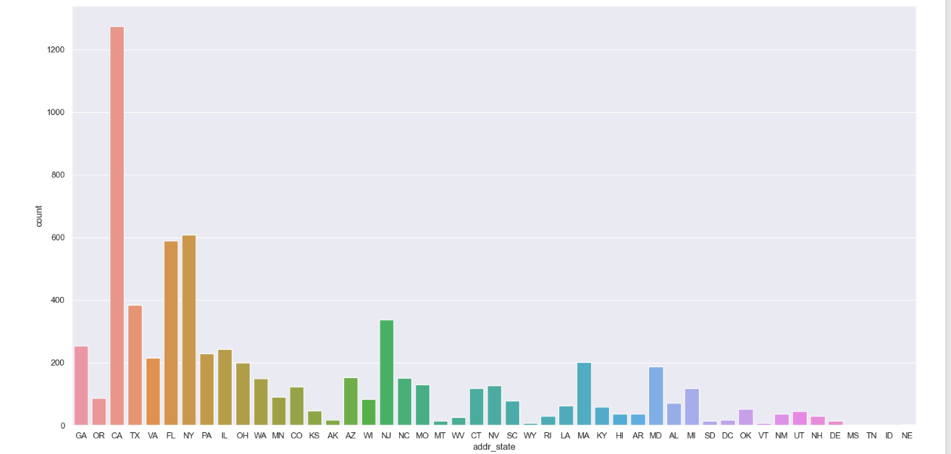
State VS Default Customers
Maximum Loan Defaulters are from states CA, FL, NY, TX, NJ

Slide 7
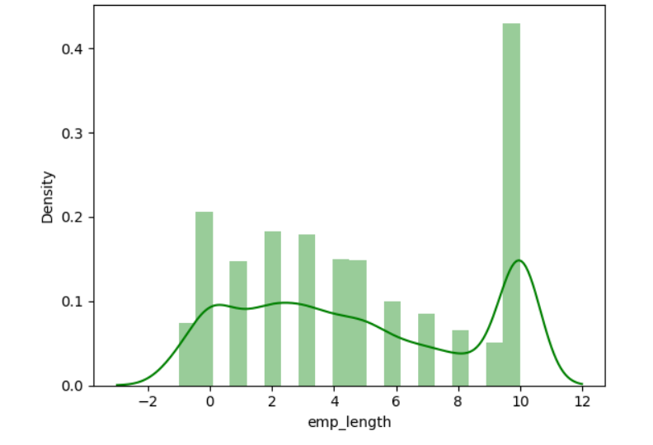
Employee Experience VS Default Customers
People with more experience are taking more loans and tend to default

Slide 8
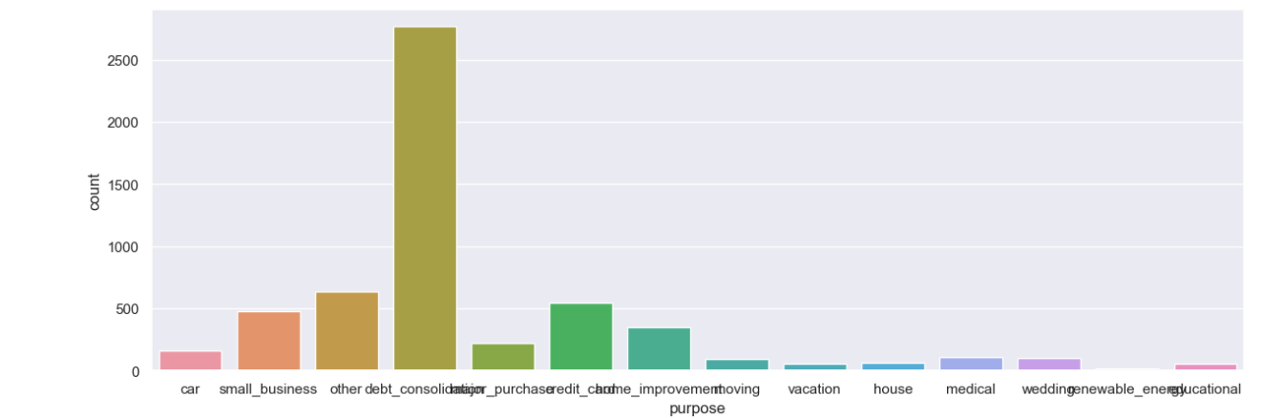
Purpose VS Default Customers
People who took Loan with reason 'Debt-consolidation' are identified as more Defaulters

Slide 9
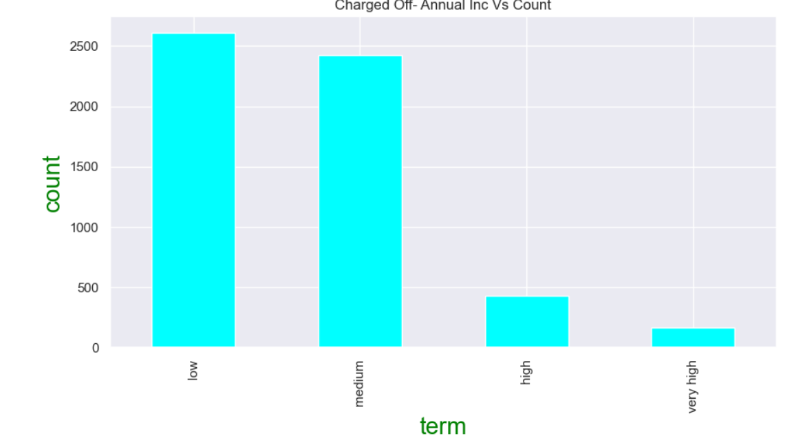
Annual Income VS Default Customers
People with Less Annual Income because of high interest rates tend to default more

Slide 10
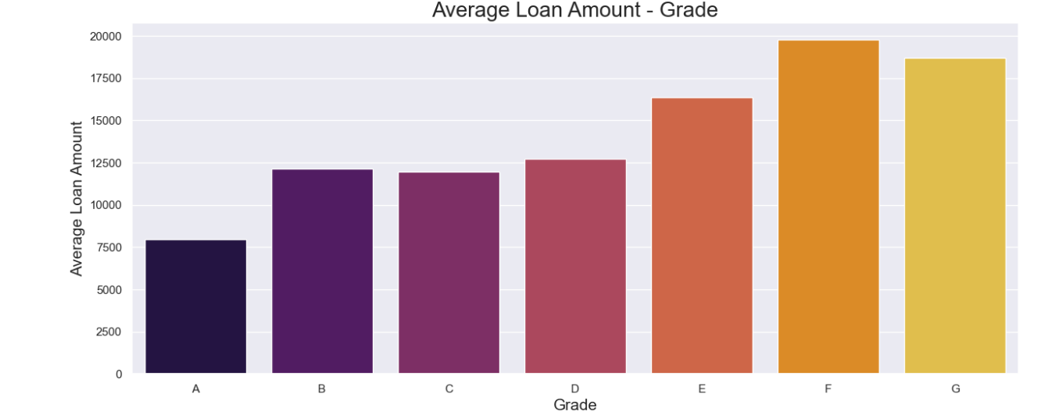
Bivariate Analysis

Slide 11
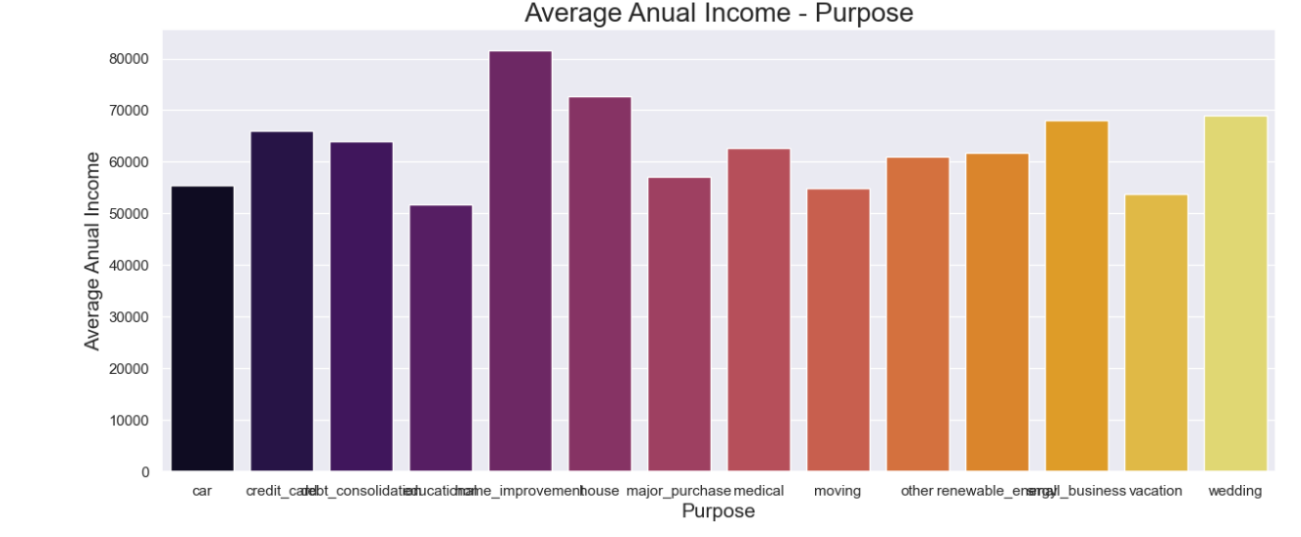
Purpose VS Annual Income of Default Customers

Slide 12
Summary
Higher percentage of Loan Borrowers are defaulting with term of 36 months
2. Individual Loan Borrowers are defaulting more
3. People with less than 1 lakh income are having high percentage to Default
4. Individuals with Grade D to G with higher income have high likely hood to default
5. People who took Loan with reason 'Debt-consolidation' are identified as more Defaulters
6. Maximum Loan Defaulters are from states CA, FL, NY, TX, NJ

